Slide 1
Moon phase diagram
Jeff Adkins

Slide 2
New
Full
1st Q
Waxing Gibbous
etc.
Phase
Phase
Triangle
6AM
midnight
noon
3 AM
etc.
high (S)
rising (E)
setting (W)
SE, SW
Time
Direction
If you know 2 of these, the third is automatically determined

Slide 3
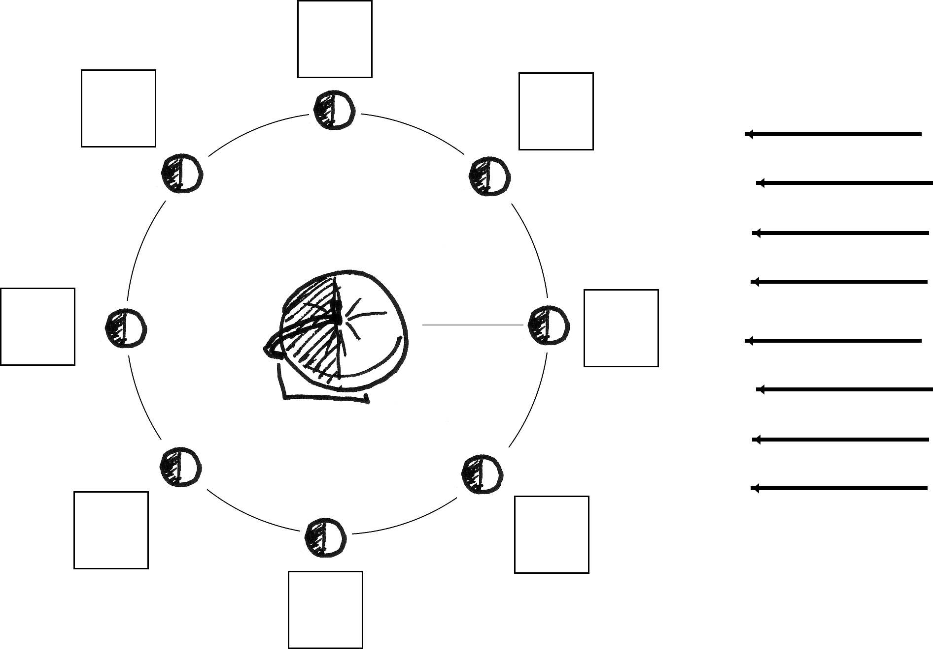
Moonrise and Moonset
WXGB
1ST Q
If you stand on the earth in the positions indicated, that’s what time it is.
WXCR
FULL
6 PM
9 PM
3 PM
midnight
noon
NEW
Sunlight
E
S
W
3 AM
9 AM
6 AM
WNGB
WNCR
“The Tool”
3RD Q
Make this on a slip of paper

