Slide 1
Build your own planetarium projector
MDAS
February 25, 2020
Jeff Adkins

Slide 2
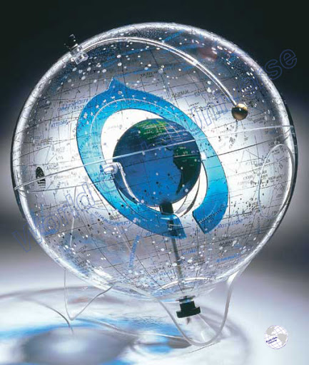
The Theory
Planetariums ostensibly simulate the appearance of the night sky by projecting or displaying stars on a surface.
Using a planetarium is like using a celestial sphere from the inside.

Slide 3
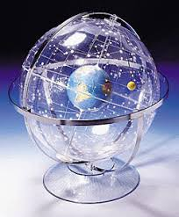
Pinhole Projection
Onto a planisphere

Slide 4
Pinhole Projection
From a planisphere

Slide 5
Projection
Onto a cylinder

Slide 6
Projection from a cylinder
From a cylinder back onto the celestial sphere

Slide 7
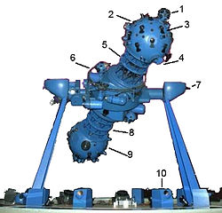
TRADITIONAL “STAR-BALL” PROJECTORS
Use a very tiny light and the “pinhole camera effect” to project light from holes to a surface to simulate the stars.
For better results use:
A very LARGE projection cylinder
A very SMALL and BRIGHT light
A very DARK room, preferably with an approximate spherical surface.
Demo: Starlab cylinder

Slide 8
How I made my template
Used the Yale Bright Star Catalog
Plotted everything 4th magnitude and brighter
Bigger dot for smaller magnitude
Added names for 2nd mag and above
Plotted cylindrical projection and radial projection
Made the scales match
605 rem ************************************************
610 rem DRAW POLAR CIRCLE OR CAP TO PROJECTOR
620 for i = 1 to 611 step 0.5
630 graphics circle i
640 next i
645 rem ************************************************
650 rem BEGIN PLOTTING STARS
660 graphics color 100,100,100
670 for i = 1 to 6000
680 if dec(i) < declimit then goto 840
700 r = (305/(90-declimit))*(90-dec(i))
710 theta = ra(i)*15*3.141593/180
720 x = r*cos(theta) : y = r*sin(theta)
725 print x,y
730 if ra > 0 and ra <= 6 then x = -abs(x) : y = -abs(y)
740 if ra > 6 and ra <= 12 then x = abs(x) : y = -abs(y)
750 if ra > 12 and ra <= 18 then x = abs(x) : y = abs(y)
760 if ra > 18 then x = abs(x) : y = abs(y)
770 print ra(i),dec(i),r,theta,x,y
780 x = xcenter+x : y = ycenter-y
785 if mag(i) < starmaglimit then
790 graphics moveto x,y
800 for j = 1 to 8-1.5*mag(i)+2 : graphics circle j : next j
805 endif
810 if constelname$(i) = "END" then 840
820 graphics moveto x+5,y+5
830 if mag(i) < maglimit then : graphics textsetup 24,12,3 : graphics drawtext starname$(i) : endif
840 next i
850 graphics color 0,0,0
860 return
870 rem ************************************************
872 rem CLEAR SCREEN SUBROUTINE
880 graphics color 100,100,100
890 for i = 0 to 640*1.5
900 graphics moveto i,0 : graphics lineto i,480*1.5
910 next i
920 return
930 end

Slide 9
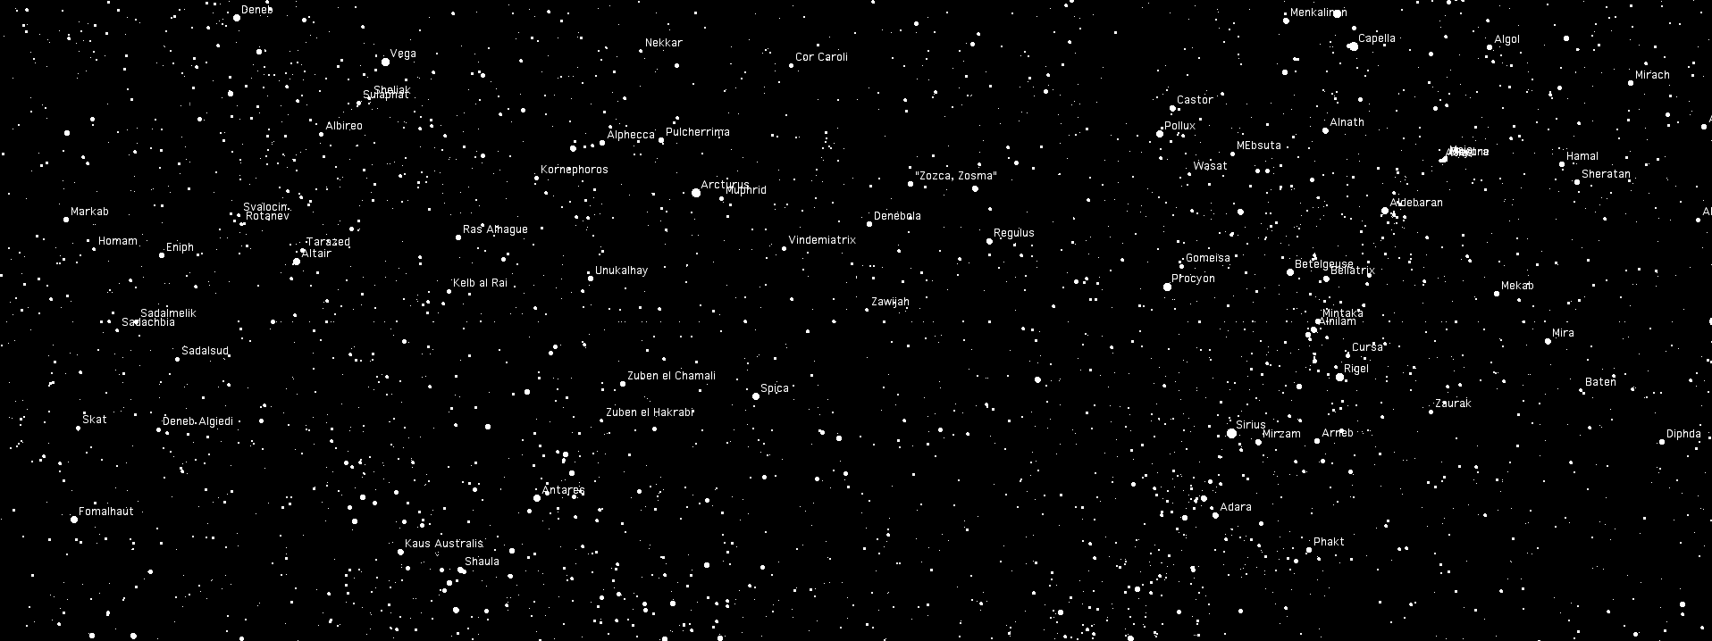
Roll your own
We’re going to build a simple cylindrical projector.
Cut out the cylinder wall and lid, making sure to leave the tabs in place for taping.
Roll the cylinder wall and connect the ends.
Attach the lid. Look for the alignment mark.
Use electrical tape to seal the joint between the lid and wall.
stars on the inside

Slide 10
Get Poky
Using a sharp pointed object such as a needle or awl, poke holes in the cylinder corresponding to the stars in the constellation you want to project.

Slide 11
Make a tiny light
You need a tiny light near the center to project the light.
My source: 24x Battery Operated LED Party Lights Bulbs for Paper Lantern Balloons Party Decoration, Waterproof - White -by LIHAO via Amazon
remove lens cap
twist to turn on
Insert into a straw
tape together
hold in center of cylinder

Slide 12
You can do better
What if you want a better projector?
Paul Bourke’s web site: http://paulbourke.net/dome/faq.html
Gives technical specs, projector recommendations, math
Basic idea: distort the image on a computer screen to bounce off a hemispherical first-surface mirror and arrive undistorted.
convex mirror
first-surface
standard projector

Slide 13
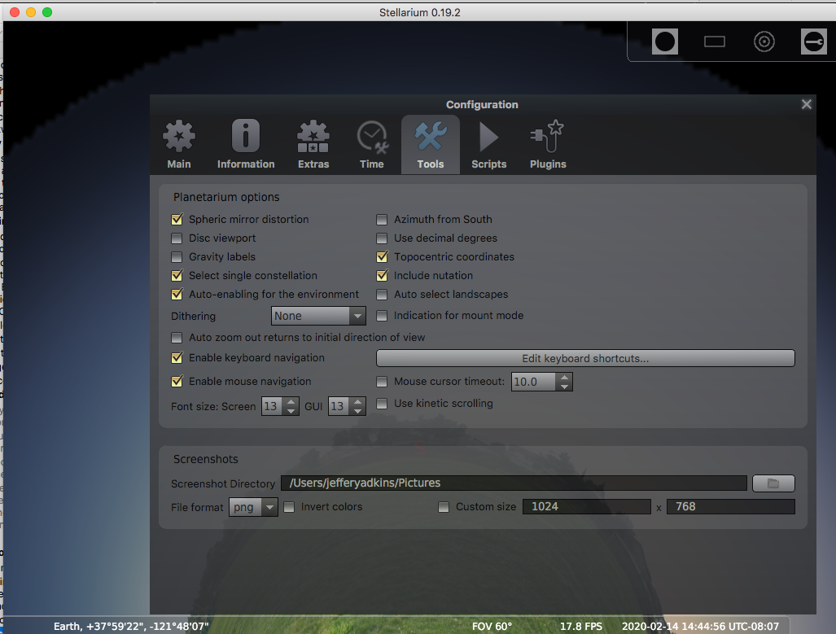
Where do you get content?
Stellarium
(Put into hemispherical mirror mode, zoom out and flatten the horizon)
www.stellarium.net
Free software for desktop
Available for phones

Slide 14
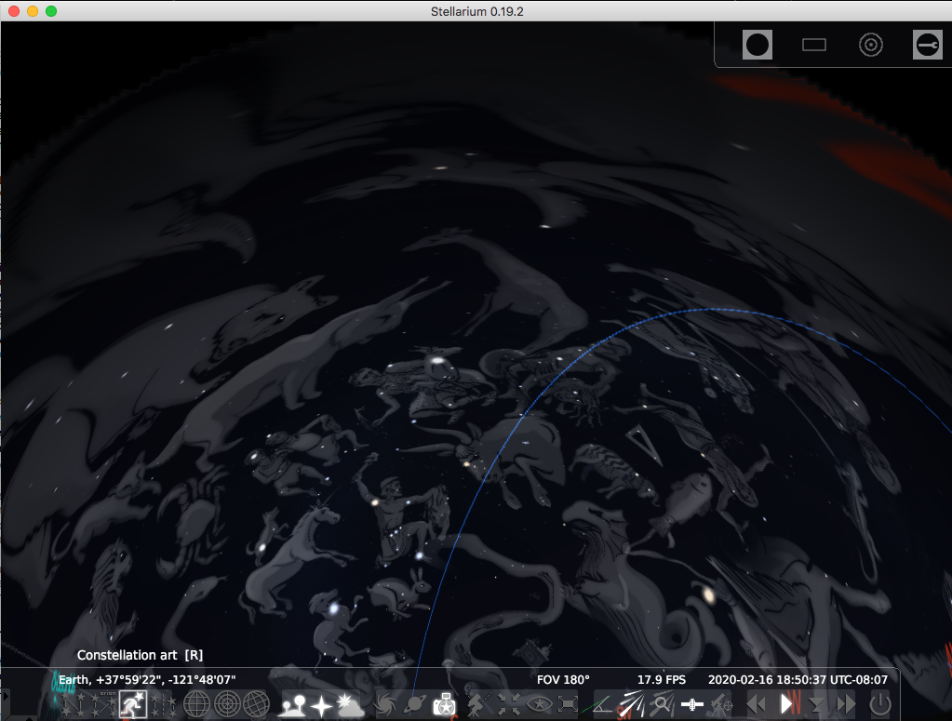
example projected content

Slide 15
Loch Ness Productions
https://www.lochnessproductions.com
Rent a show for $30 (includes show license for 3 days)
Select “Prewarped” format
DVHS Planetarium uses this service on an inflatable dome

Slide 16
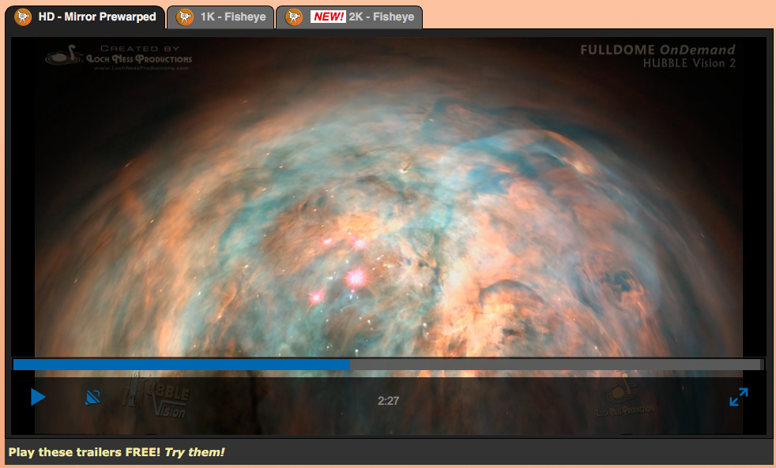
Loch Ness Shows

Slide 17
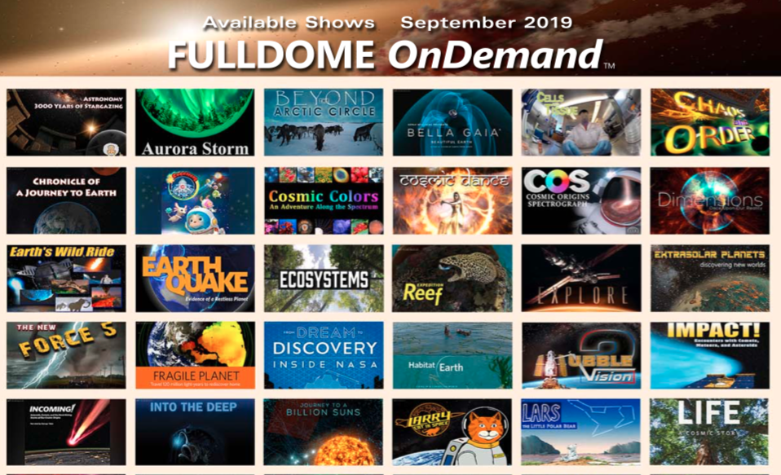
Half

Slide 18
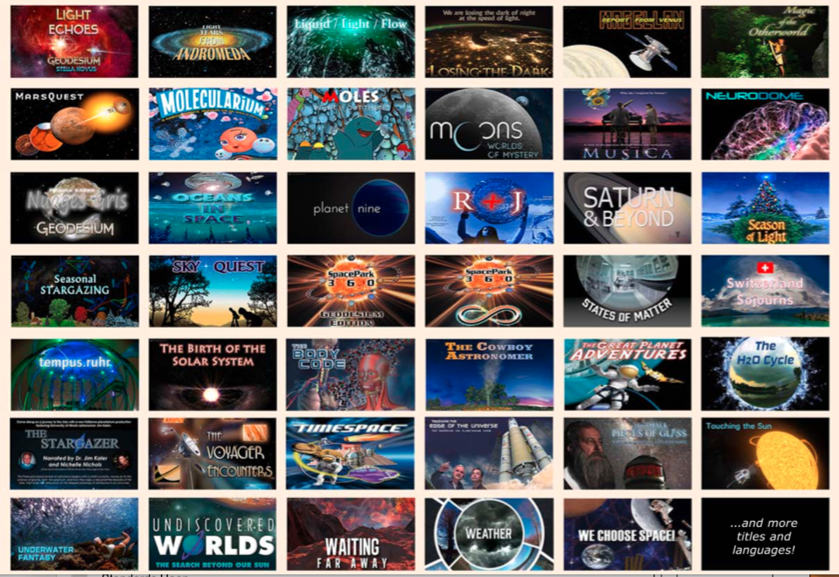
Other half

